Slide 1

Data Visualization Main factors associated with hiring at UN agencies
AbdelRahman Yaghi (20200355)
Alexandra Jaberi (20200129)
Sondos Ali (20200438)
Heba Najdawi (20190959)
Raghad Joudeh (20200777)
Rakan Armoush (20190009)
Omar Attawneh (20200191)

Slide 2
Problem Statement

Slide 3
Data exploration
01
Miscalculations
02
Missing Data

Slide 4
Procedure
Step 1
Data Exploration
Step 2
Data Cleaning
Step 3
Graph features that might have correlation
Step 4
Use statistical methods to confirm /debunk our theories
Step 5
Chose our top three insights based on the successful theories

Slide 5
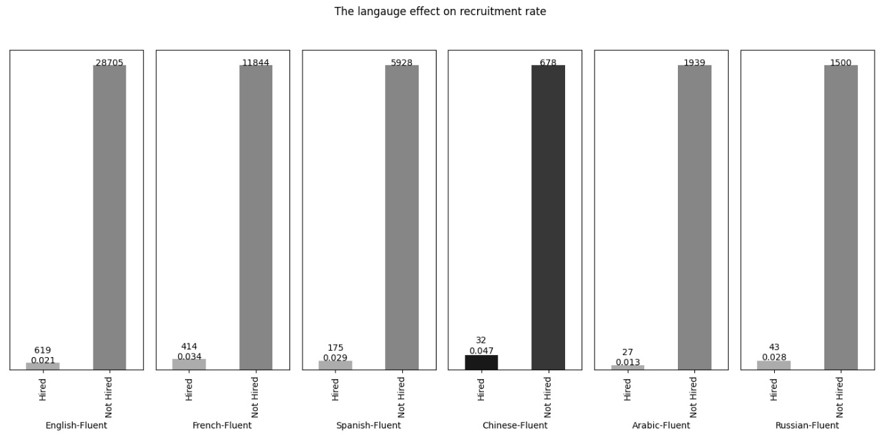
Insight One

Slide 6
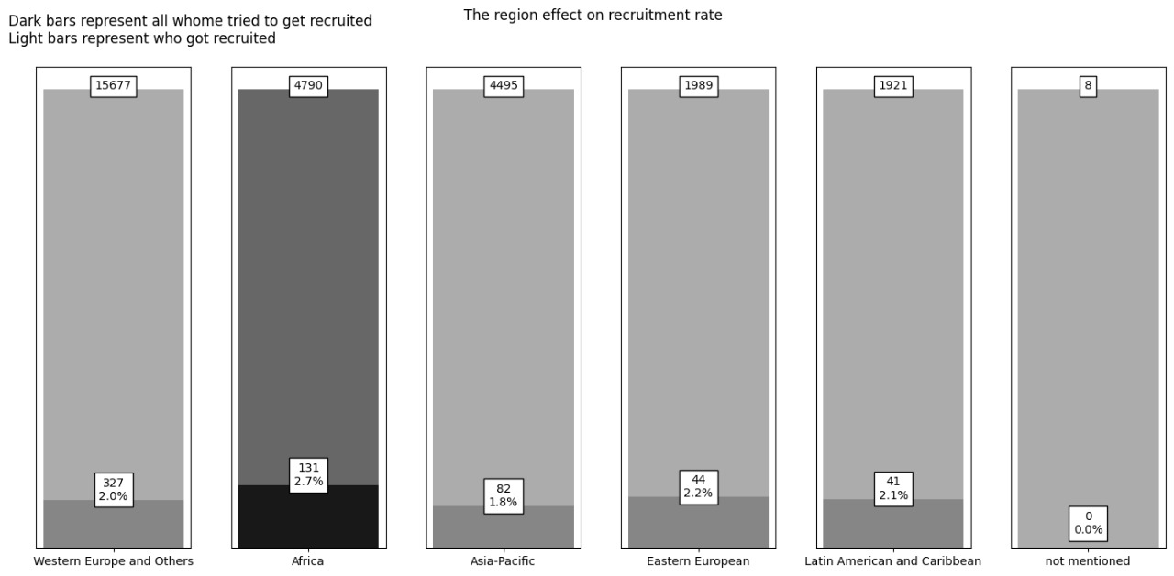
Insight Two

Slide 7
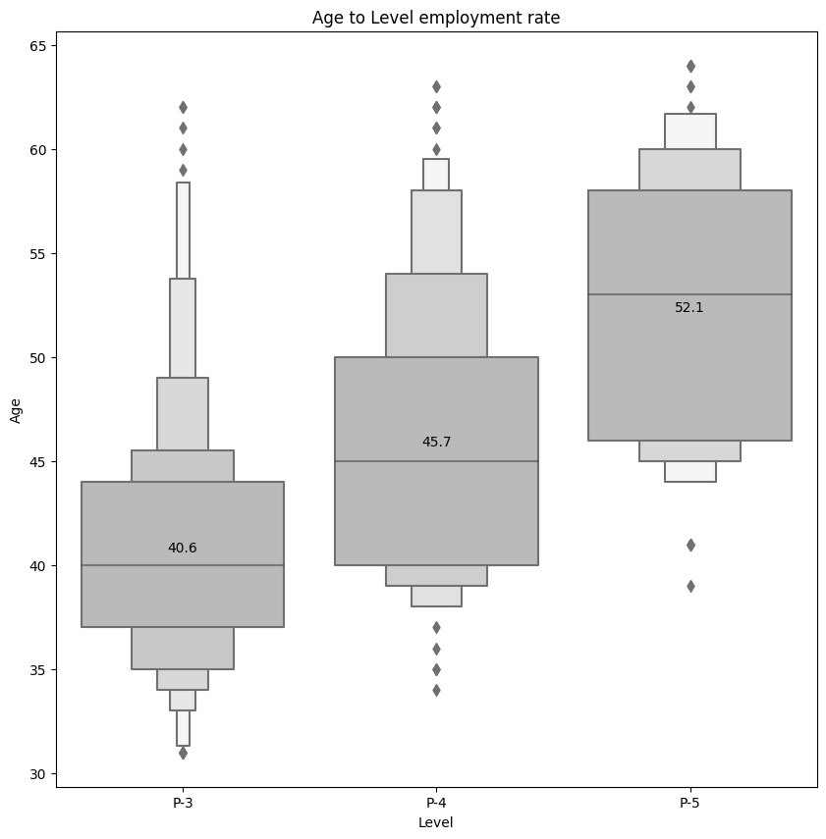
Insight Three

Slide 8
Conclusion

Slide 9
Recommendation
Having a dataset named “InnerEntries” of people who got promoted / demoted.
Removing the features “Posting Year” and “Selection Year”.
Each employee should exist once in the recruitment dataset.
New roster entries should cancel the older entries for the same person.
Creating “Posting_Date” and “Acceptance_Date” features for the dataset “InnerEntries”.
New “InnerEntries” applications should cancel the older entries if the older ones weren’t approved yet.

